Slide 1
Date a Scientist
Machine Learning Fundamentals
Jeremy Sia
November 2, 2018

Slide 2
Table of Contents
Exploration of the Dataset
Questions to Answer
Augmenting the Dataset
Classification Approaches
Regression Approaches
Conclusion / Next Steps

Slide 3
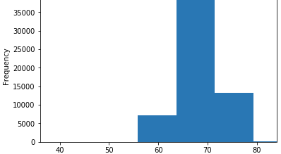
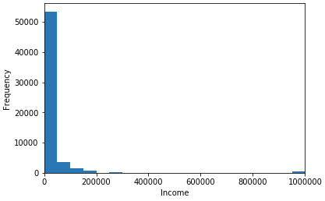
Exploration of the Dataset
There were only a few columns containing numerical values, so I explored height and age. It appears that the bin from 64 to 72 has the highest frequency, suggesting that the data is in inches. I also explored income level, and it seems like the vast majority of income levels is below $50k, with a very small number of people earning close to $1m.

Slide 4
Questions to Answer
I wanted to see if we could predict orientation from body type and height (classification).
I also wanted to see if we could use height and age to predict income (regression).

Slide 5
Augmenting the Dataset
I created two new columns for orientation and body type.
In order of frequency, I labeled orientation from 0 to 2 (0 being the most frequent) and body type from 0 to 11 (0 being the most frequent)

Slide 6
Classification Approaches
Using the SVM model, I got an accuracy score of 0.8585.
Using the KNN Model with 5 nearest neighbors, I got an accuracy score of 0.8542.
The SVM model takes significantly longer to run with not much additional accuracy.
The KNN Model also appears to be simpler than the SVM model.

Slide 7
Regression Approaches
The Multiple Linear Regression had a coefficient of less than 0.01
Both models ran decently quickly, but it seemed like K Nearest Neighbors was simpler

Slide 8
Conclusion / Next Steps
It appears that we can predict orientation from body type and height.
However, we can’t use height and age to predict income.
Next steps are to test the predictions with education level and offsprings.
I would have preferred more quantitative data on which I could have done regression analysis.

